Slide 1
Servlet Package
javax.servlet
Servlet interface defines methods that manage servlet and its communication with clients
Client Interaction: When it accepts call, receives two objects
  ServletRequest
  ServletResponse

Slide 2
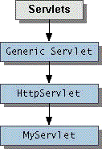
Architecture

Slide 3
Servlet Life Cycle
Server loads and initializes servlet
servlet handles client requests
server removes servlet
Servlet can remain loaded to handle additional requests
Incur startup costs only once

Slide 4
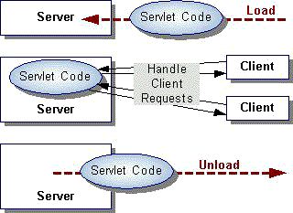

Slide 5
Servlet Initialization and Destruction
Servlet’s init() method
Create I/O intensive resources (database)
Initialization parameters are server specific
Seen in servletrunner properties file
destroy() method
make sure all service threads complete

Slide 6
